Slide 1
EMC/NCO implementation Kick-off meeting, September 04, 2013
North American Land Data
Assimilation System (NLDAS)
Version 1.0 -- a New Implementation
Michael B. Ek, Youlong Xia and Yuqiu Zhu

Slide 2
Is this a DOC, NOAA, NWS, NCEP or Center Milestone?
Yes. (part of NWS AOP)
NLDAS is a multi-institution (e.g., NOAA/NCEP, NWS/OHD, NASA/GSFC, Princeton University, University of Washington, etc.) collaboration project initiated in 2000. Since 2008, it has been executed on EMC local sever (tempest) in a quasi-operational mode through a cron job to support US operational drought monitoring and prediction, government agencies, private sectors, and academia community.

Slide 3

North American Land Data Assimilation System (NLDAS)
• Multi-land-modeling & land data assimilation system.
• Uncoupled land model runs driven by atmospheric forcing using surface meteorology data sets.
• Long-term retrospective and near real-time runs.
• Land model output of water and energy budgets.
• 30-year land model runs provide climatology.
• Anomalies used for drought monitoring and water resources.
• Multi-institute collaboration (NCEP, OHD, NASA, Princeton, Univ. Wash.).

Slide 4
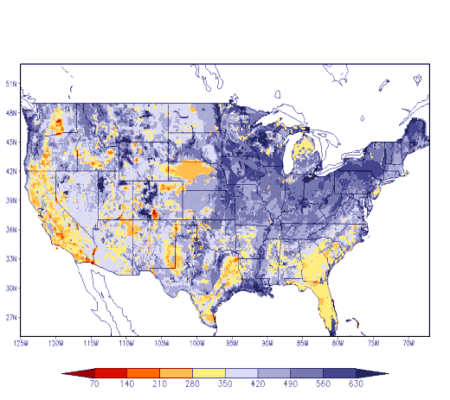
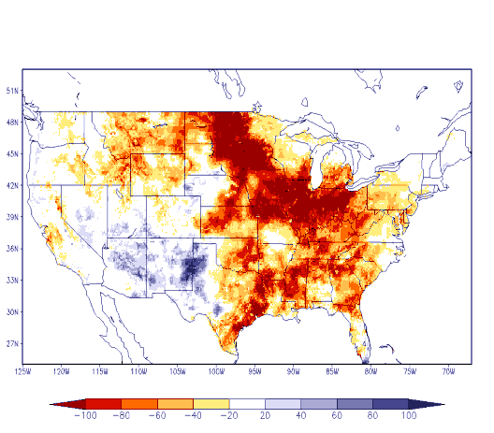
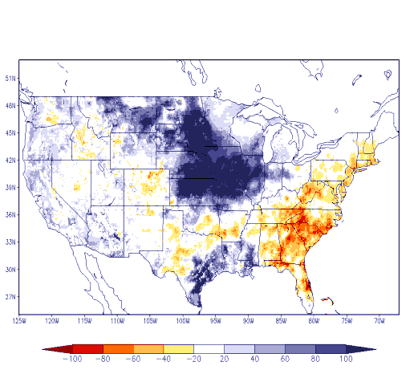
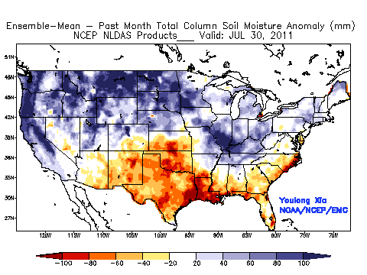
North American Land Data Assimilation System (NLDAS)
Land models: Noah, SAC, VIC, Mosaic run in “uncoupled” mode.
Forcing: CPC observed precipitation, and atmospheric forcing from NCEP North American Regional Climate Data Assimilation System.
Climatology from land model assimilation runs for 30-years.
Output: 1/8-deg. land & soil states, surface fluxes, runoff/streamflow.
Anomalies used for drought monitoring; supports NIDIS.
Operational transition at NCEP in 2013. Future: higher resolution, land model upgrades, improved forcing, snow & soil moisture assimilation.
NLDAS research supported by NOAA Climate Program Office.
www.emc.ncep.noaa.gov/mmb/nldas (Ek et al., 2011)
July 30-yr climate
July 1988 (drought)
July 1993 (flood)
July 2011 (Tx drought)
NLDAS four-model ensemble monthly soil moisture anomaly

Slide 5
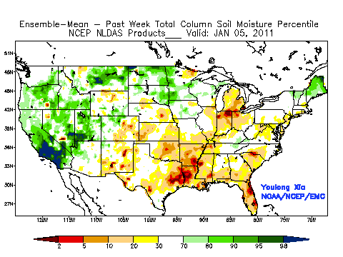
NLDAS: 2011 Texas Drought
Near real-time weekly 4-model ensemble total soil moisture percentile, 5 Jan – 14 Sept 2011
(D0 yellow/moderate – D4 red/extreme)
Notes:
NLDAS example – U.S. drought in 1988 and flood in 1993.

Slide 6
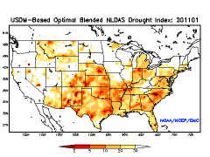
NLDAS: 2012 US Drought
USDM-based optimally blended NLDAS Drought Index, Jan 2011 – Aug 2012
(D0 yellow/moderate – D4 red/extreme)
Notes:
NLDAS example – U.S. drought in 1988 and flood in 1993.

Slide 7
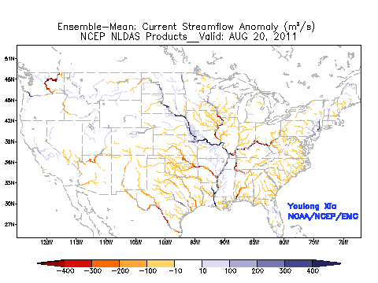
NLDAS: Flood Monitoring
Ensemble mean daily streamflow anomaly (m³/s)
Hurricane Irene and Tropical Storm Lee
20 August – 17 September 2011

Slide 8
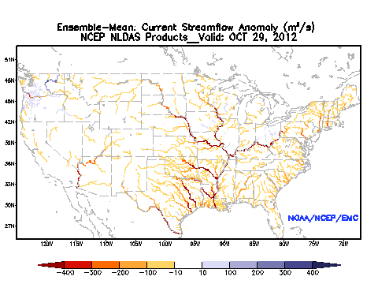
NLDAS: Flood Monitoring
Ensemble mean daily streamflow anomaly (m³/s)
Superstorm Sandy
29 October – 04 November 2012

Slide 9
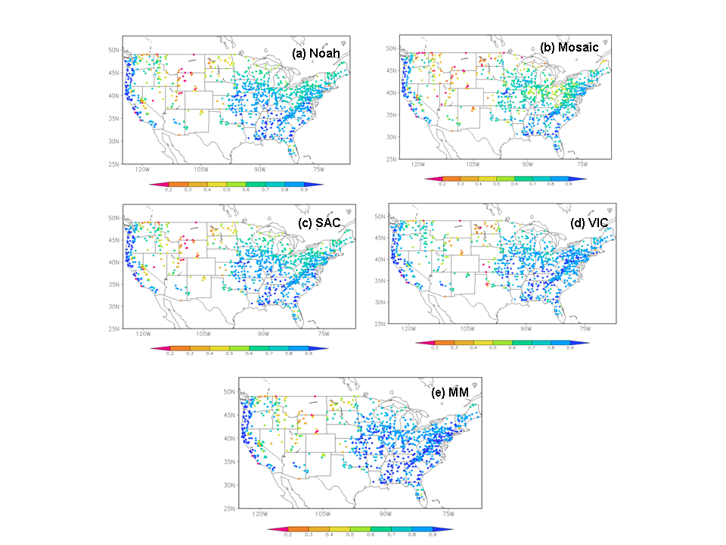
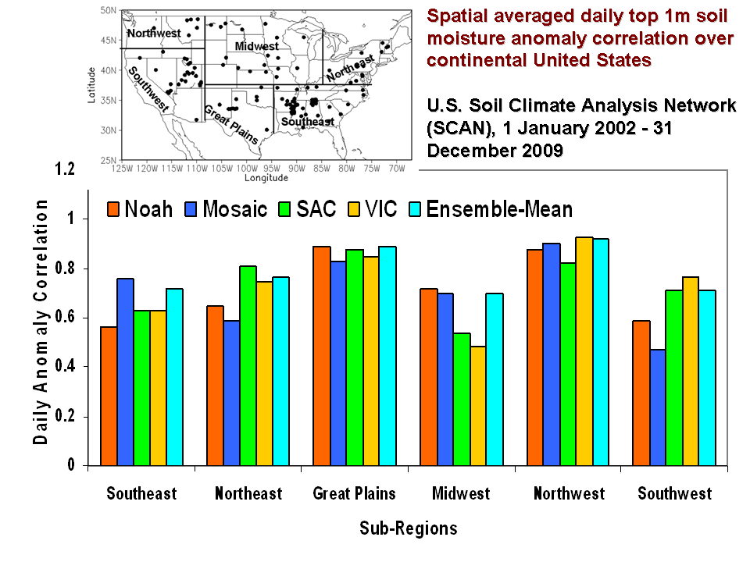
NLDAS: Evaluation and Validation
• Energy flux validations from tower sites: net radiation, sensible, latent & ground heat fluxes.
• Water budget: evaporation, total runoff/streamflow.
• State variables: soil moisture, soil temperature, skin temperature, snow water equivalent, snow cover.
(Xia et al., JGR, 2012a; 2012b)
(Xia et al., 2013, J. Hydrology, under review)
Ensemble Mean
Monthly streamflow anomaly correlation
(1979-2007 USGS measured streamflow)
Daily top 1m soil moisture anomaly
correlation (2002-2009 US SCAN Network)

Slide 10
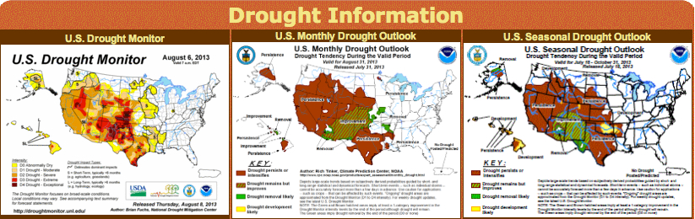
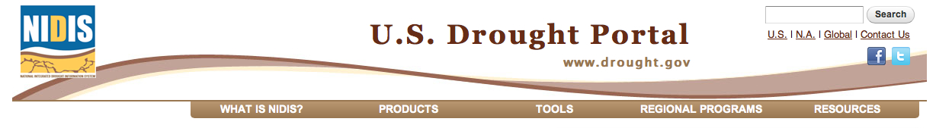
NLDAS: Users
NCEP/CPC Drought Monitoring & Drought Outlook (www.cpc.ncep.noaa.gov/products/Drought)
US Drought Monitor (www.droughtmonitor.unl.edu)
US Drought Portal/National Integrated Drought Information System (NIDIS) (www.drought.gov)
Other government, academic, private users.

Slide 11
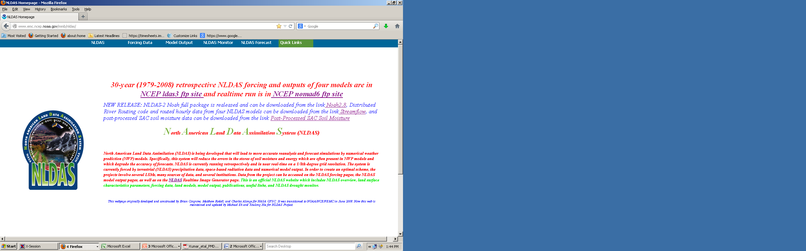

NLDAS: Web Site Information
NCEP/EMC NLDAS Website
NASA/GSFC NLDAS Website

Slide 12
Overview of NLDAS Scope
NLDAS Forcing Generation
[RCDAS interpolation to NLDAS grid, gauge precipitation adjustment and downscaling (US gauge, Global Gauge, CMORPH, Stage II ) and radiation bias-correction ]
NLDAS Model Run
(Noah, Mosaic, SAC, VIC)
NLDAS River Routing Run
(for 4 NLDAS Models)
Product Delivery
(COPY forcing a and b file, outputs from 4 models, routed streamflow from four models to com directory)

Slide 13
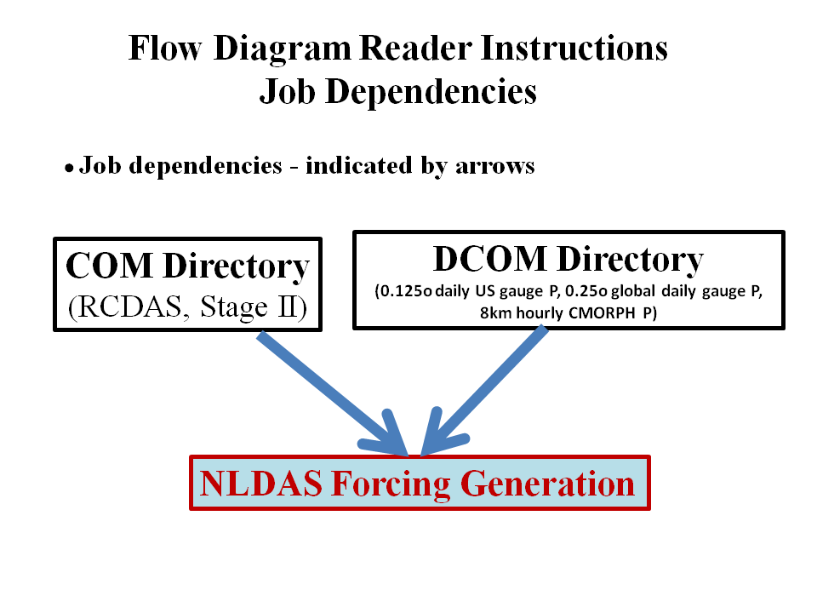
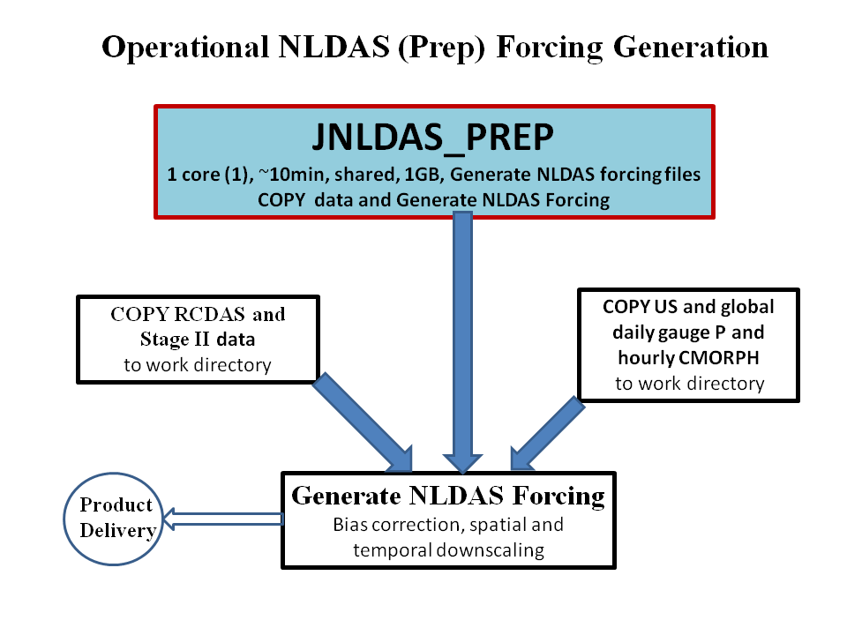
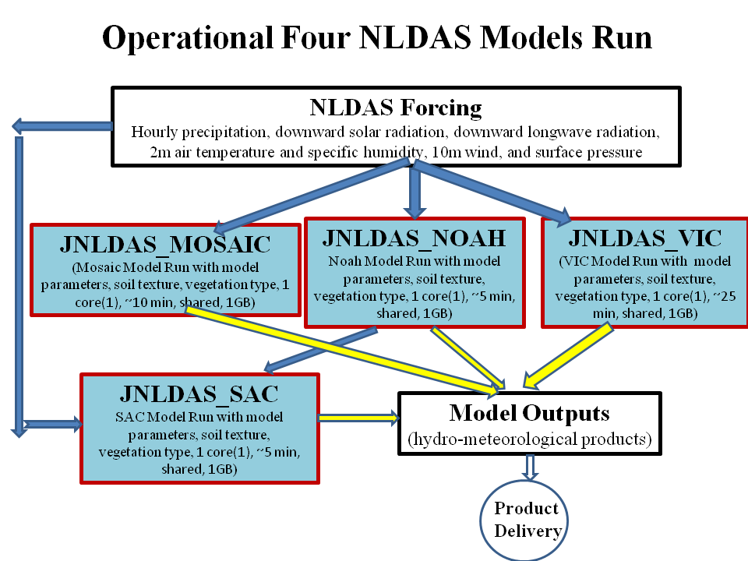
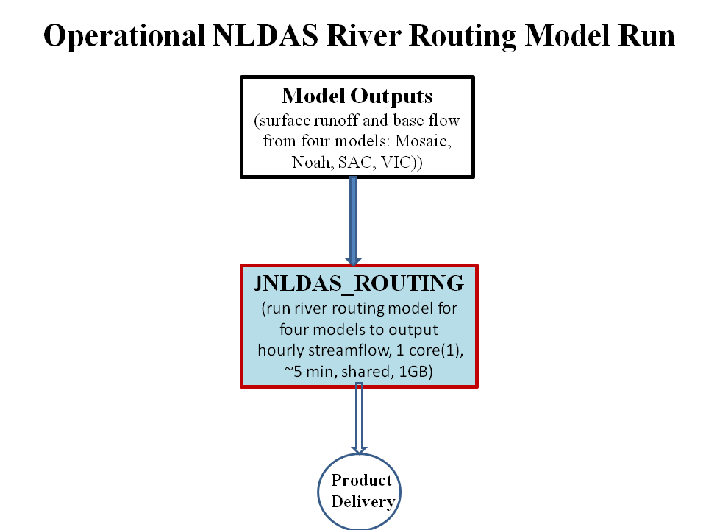
Overview of JJOB Workflow Diagram
a
1
2
3

Slide 14
Development Testing
Preparation of scripts and jobs for R2O transition: yes
Bugzilla findings: no
Standards followed (SMS, alerts, output, cleanup, monitoring, mirrioring, etc): yes
Parallel Evaluation Recommendations
(i) Evaluation that has occurred outside of EMC thus so far (if any)
CPC, OHD, NASA, USDA, Academia, private sectors, universities
(ii) Length of time based on scientific and software changes
~ 4 years
(iii) Recommended evaluators
NLDAS products and software have been comprehensively evaluated (and continue to be) by both EMC NLDAS team and its collaborators.

Slide 15
Implementation Planning Questions/Topics
CPU and Disk (include this in the RFC’s)
~40 min
~ 4GB
Post Production and Product Generation Requirements (status quo?)
Output
Will any new products be created? Yes
Will the format be changing? No
Will new products require GEMPAK or other development? No
How will the data be disseminated (AWIPS, FTP, NOMADS, etc)? EMC/nomad6, NASA/DISC
Library Changes (CNVGRIB, W3LIB, etc) No
Downstream Dependencies
No downstream dependencies
Data Flow requirements N/A
Status of TIN
Ready anytime by call
Vertical structure ready: yes
EE ready: We have SVN account, and will put NLDAS codes and scripts into SVN
RFC ready: Not yet.
30-Day evaluation: Needed?

Slide 16
North American Land Data Assimilation System: New Capability
Project Status as of 12 Aug 2013
G
Project Information and Highlights
Y
Scheduling
Lead: Mike Ek, Youlong Xia, EMC, Chris Magee, NCO
Scope:
Implement North American Land Data Assimilation System (NLDAS, Version 1.0) to enhance US operational drought monitoring and prediction; CONUS domain.
Transition long-term NLDAS project to operations.
Six components: (1) NLDAS atmospheric forcing generation; Land model runs: (2) Noah, (3) Mosaic, (4) SAC-SMA, and (5) VIC; (6) River routing model run.
Expected Benefits:
Reliable and stable (operational) products for US operational drought monitoring and prediction.
Provide initial land states to regional weather and climate models for use by research community.
Speed up operational land/hydrological model development and guidance for future NLDAS versions.
Milestone (NCEP) | Date | Status
EMC testing complete/ EMC CCB approval | 15 SEP | TBD
Final RFC submitted to NCO | 15 SEP | TBD
Technical Information Notice Issued | 15 SEP | TBD
Initial Test Complete | 15 SEP | TBD
CCB approve parallel data feed | 15 SEP | TBD
IT testing begins | 15 SEP | RBD
IT testing ends | 22 SEP | TBD
Parallel testing begun in NCO | 15 SEP | TBD
Real-Time Evaluation Ends | 15 OCT | TBD
Management Briefing | 23 OCT | TBD
Implementation | 30 OCT | TBD
G
Issues/Risks
G
Finances
Issues:
None
Risks:
None
Mitigation:.
N/A
Associated Costs:
None
Funding Sources:
NOAA CPO MAPP project: R2O 12 Man-months
NCO Base: 1-2 man-months for implementation
EMC Base: 1-2 man-month annually for maintenance
Management Attention Required | Potential Management Attention Needed | On Target
R
Y
G

Slide 17
NLDAS Evolution to 2018
System | Current | Q2FY14 | Q1FY18
NLDAS | Quasi-operational NLDAS phase 3 | Operationalize NLDAS phase 3 (NLDASv1.0) | NLDAS phase 4 (NLDASv2.0)
(North American Land Data Assimilation System) | 4 land-surface models (LSMs) run in uncoupled mode: NCEP/Noah, OHD/SAC, Princeton-UW/VIC, NASA/Mosaic | 4 LSMs | 4 LSMs, with upgrades to Noah LSM and other LSMs, replace NASA/Mosaic with NASA/Catchment LSM
Drought support for NCEP/CPC, NIDIS, U.S. Drought Monitor, others | Serial job | Serial job | “Parallel architecture” using NASA Land Information System (LIS), including land data assimilation
 | 1/8-degree CONUS domain (14km) | 1/8-degree CONUS domain (14km) | 3-km North American domain (match NAM)
Estimated compute factor | Runs on NCEP/EMC tempest | 1 (1 node for 37 minutes once per day on WCOSS) | 10 (increased domain size, resolution, land data assimilation)
Notes:
Compressed for display purposes

